Slide 1


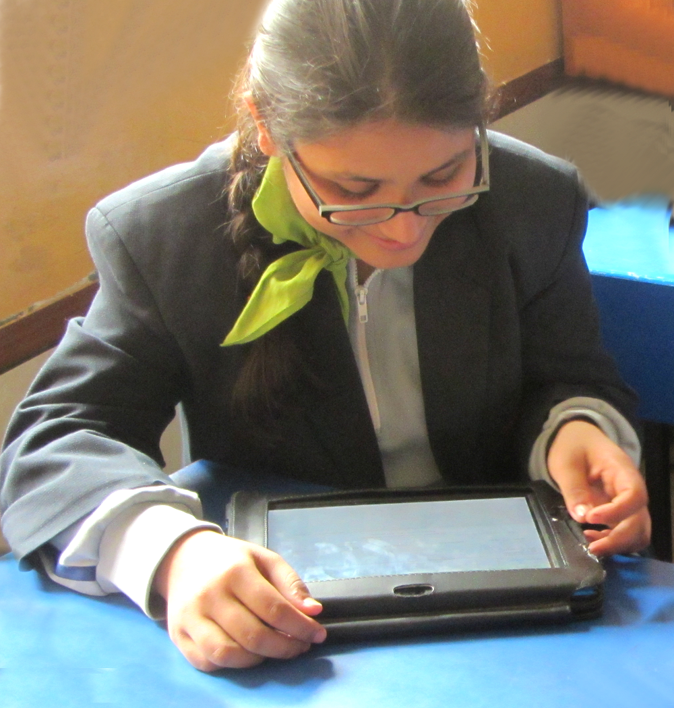
Tecknowscope Solutions LLP
Online Examination Solution for Schools, Colleges, Universities, Institutes, Corporates, Retail Students
Government
www.tecknowscope.com | www.lovemytest.com | Bengaluru India

Slide 2
Problems Addressed
Examination Solutions for Schools
1. Scalable Online examination to conduct large examinations online where thousands of students can take tests simultaneously.
2. Proctored online exam conductions with question by question progress tracking for every student. Remote control for the invigilator to start, stop, pause, extend a test at a student level in real time.
3. Quality School Question Paper Generation: Teachers can generate question papers instantly with the click of few buttons. Teachers do not need to spend days to create question papers and do copy paste jobs.
4. Live reports for students and parents with solutions to understand the results with transparency.
Uniqueness
  Teachers will be able to generate questions papers with a blueprint, choosing the chapters, difficulty levels or choosing percentage of textbook and previous year questions.
  Objective as well as Subjective tests (Most online platforms do objective tests alone)
  Teachers can assign homework tests and practice tests online.
  Technology based assessments to remove pen and paper tests and remote evaluation of papers as a service.
  Affordability to reach Tier2, Tier3 cities
  AI based evaluation (TBD)
www.tecknowscope.com | www.lovemytest.com | Bengaluru India

Slide 3

Examination Solutions for Schools
With Lovemytest, conduct proctored online exams, subjective and objective online tests, generate question papers instantly, monitor and track progress remotely, prevent cheating, evaluate answer sheets online, annotate on answer sheets, publish results to students and even print/make pdfs of answer sheets for records.
www.tecknowscope.com | www.lovemytest.com | Bengaluru India

Slide 4

CONDUCT ONLINE EXAMS
Examination Solutions for Schools
SUBJECTIVE AND OBJECTIVE TESTS
ONLINE EVALUATION SYSTEM
MONITOR EXAMS REMOTELY
TRACK QUESTION BY QUESTION PROGRESS
START, STOP, RESUME, RESCHEDULE TESTS
GENERATE QUESTION PAPERS ONLINE
PREVENT CHEATING
INSTANT RESULTS
AWS CLOUD BASED SYSTEM
www.tecknowscope.com | www.lovemytest.com | Bengaluru India

Slide 5
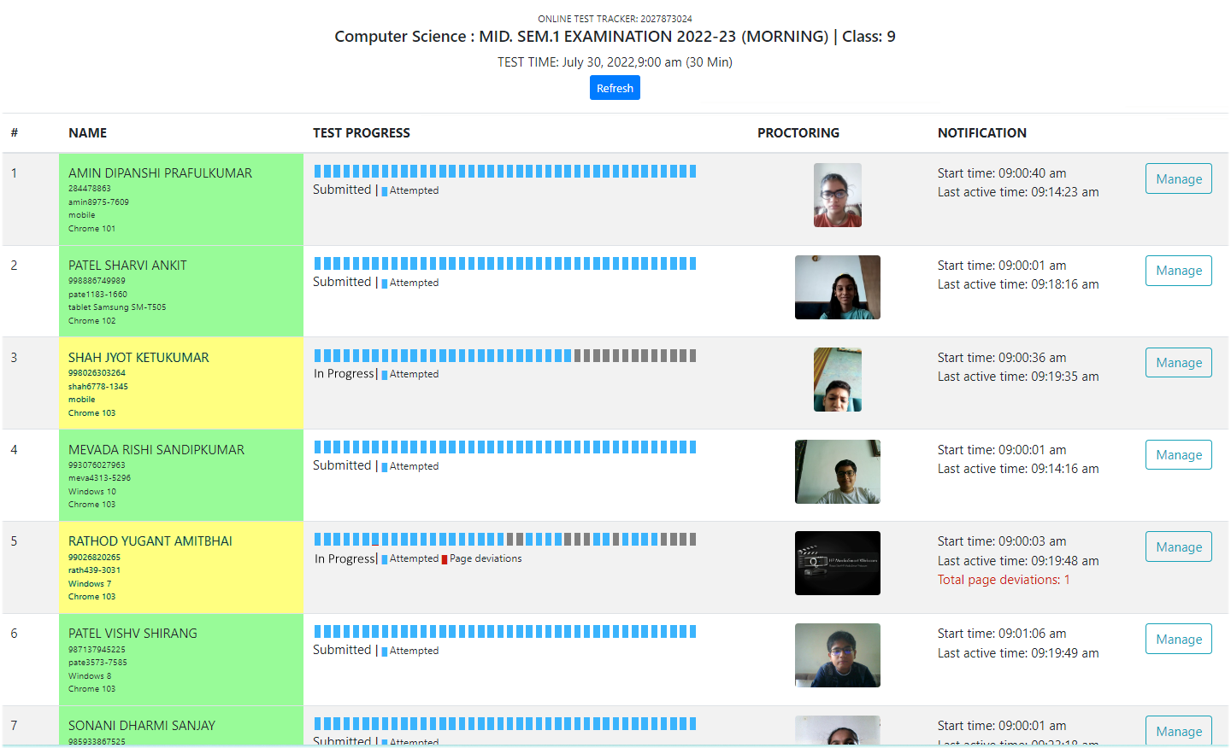
MONITOR STUDENTS LIVE REMOTELY
Examination Solutions for Schools
QUESTION BY QUESTION PROGRESS TRACKER
REMOTE PROCTORING
AUTOMATIC RANDOM PHOTOGRAPHS OF STUDENTS
START, STOP, RESUME TESTS
RESCHEDULE TESTS FOR ALL OR FOR SPECIFIC STUDENTS
CHECK IF STUDENTS ARE CHEATING
DEVIATION REPORTING
KNOW THE SYSTEM DETAILS OF STUDENTS
EXTEND TEST TIME FOR SPECIFIC STUDENTS
TERMINATE TESTS FOR SPECIFIC STUDENTS
www.tecknowscope.com | www.lovemytest.com | Bengaluru India

Slide 6
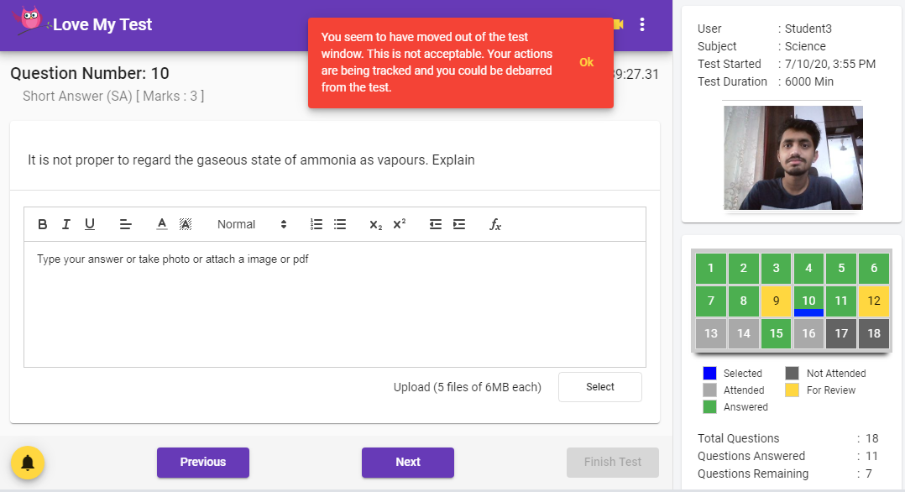
SUBJECTIVE EXAMINATIONS
Examination Solutions for Schools
10 DIFFERENT TYPES SUBJECTIVE QUESTIONS
ANSWERS CAN BE TYPED-IN OR WRITTEN ON PAPER AND PHOTOS TAKEN FROM SYSTEM
UPLOAD UP TO 5 ANSWER PAGES PER QUESTION
TEACHERS CAN EVALUATE STUDENT BY STUDENT
CAN HAVE BOTH SUBJECTIVE AND OBJECTIVE QUESTIONS
RESULTS CAN BE PUBLISHED ONLINE
STUDENTS/PARENTS CAN ACCESS RESULTS WITH SOLUTIONS
SUBJECTIVE EVALUATION
TEACHERS GET AN EVALUATION PANEL
EVALUATE ONLINE, GIVE MARKS AND ADD COMMENTS
ANNOTATE ON ANSWER PHOTOS SUBMITTED BY STUDENTS
SHARE WITH OTHER TEACHERS TO EVALUATE
www.tecknowscope.com | www.lovemytest.com | Bengaluru India

Slide 7
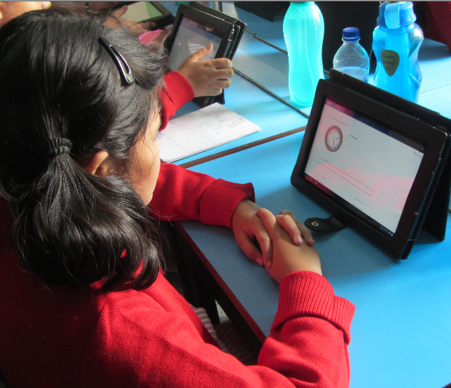
OBJECTIVE EXAMINATIONS
Examination Solutions for Schools
MULTIPLE CHOICE AND TRUE AND FALSE QUESTIONS
TIMED TEST GETS SUBMITTED AUTOMATICALLY
EVALUATION DONE AUTOMATICALLY
INSTANT SCORE SHEETS
MULTIPLE SUBJECT TESTS
TESTS WITH MULTIPLE SUBJECTS IN ONE EXAM
SUITABLE FOR ENTRANCE EXAMS
OTHER OPTIONS
OPTION FOR NEGATIVE MARKING
OPTION FOR SHUFFLING QUESTIONS FOR EVERY STUDENT
OPTION TO SET THE LATE ENTRY TIME LIMIT
OPTION TO HARDSTOP A TEST IRRESPECTIVE OF START TIME
www.tecknowscope.com | www.lovemytest.com | Bengaluru India

Slide 8
CHEATING PREVENTION
Examination Solutions for Schools
TIMED TESTS STARTS AND ENDS ON TIME
STUDENTS VERIFY THEIR CREDENTIALS AND SYSTEM TAKES A PHOTOS TO START THE TEST
TEACHER DASHBOARD TO KNOW STUDENT DEVIATIONS AND CAN TERMINATE, PAUSE, RESUME OR RESCHEDULE TESTS AT STUDENT LEVEL
STUDENTS CANNOT COPY PASTE ANSWERS
STUDENTS CANNOT BROWSE TO OTHER SITES
STUDENTS CANNOT LOGIN FROM TWO DEVICES SIMULTANEOUSLY
VIDEO OF THE STUDENTS RUNNING ON STUDENT DEVICES WHILE EXAM IS ON.
SYSTEM AUTOMATICALLY TAKES PHOTOS OF STUDENT WHILE EXAM IS ON
STUDENTS’ PHOTOS AVAILABLE EVEN AFTER EXAMINATION TIME TO CHECK ANY CHEATING
www.tecknowscope.com | www.lovemytest.com | Bengaluru India

Slide 9
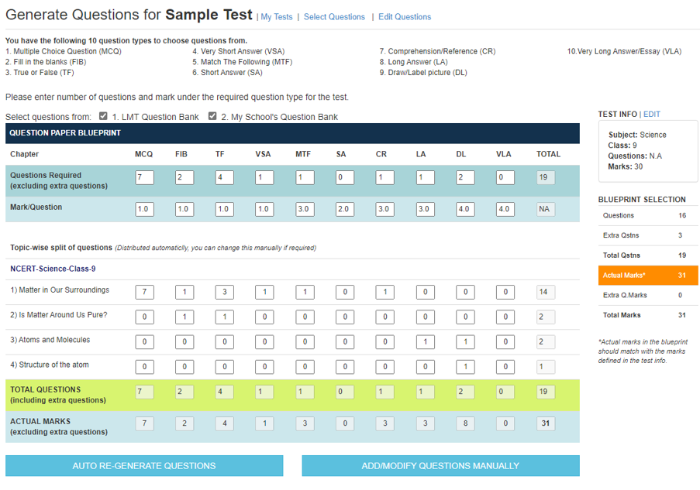
QUESTION PAPER GENERATOR
Examination Solutions for Schools
GENERATE QUESTION PAPERS AUTOMATICALLY
TEACHERS CAN CHANGE SELECTED QUESTIONS
CHOOSE QUESTIONS AS NEEDED
ADD YOUR OWN QUESTIONS
ADD QUESTIONS IN REGIONAL LANGUAGES TOO
10 DIFFERENT TYPES OF QUESTIONS TO CHOOSE FROM
QUESTIONS WITH SOLUTIONS
TEACHERS COPY OF QUESTION PAPER WITH SOLUTIONS
READY CONTENT FOR CBSE/NCERT 1-12 ALL SUBJECTS
QUESTIONS WITH EQUATIONS AND FORMULAS
MCQ OPTIONS CAN BE EVEN IMAGES
5-MINUTE PROCESS TO GENERATE QUESTION PAPERS AUTOMATICALLY WITH THE HELP OF A BLUE PRINT
www.tecknowscope.com | www.lovemytest.com | Bengaluru India

Slide 10
PUBLISHING RESULTS
Examination Solutions for Schools
SCHOOLS CAN PUBLISH RESULTS ONLINE WHEN NEEDED
STUDENTS CAN VIEW THE RESULTS ONLINE
STUDENTS CAN COMPARE THEIR ANSWERS WITH CORRECT ANSWERS
THEY CAN VIEW THE MARKS, TEACHERS COMMENTS AND THE ANNOTATIONS DONE BY THE TEACHER
REPORTS
REPORTS GENERATED INSTANTLY
REPORTS CAN BE DOWNLOADED AS EXCEL FILES
QUESTION BY QUESTION REPORT FOR EVERY STUDENT
ENTIRE ANSWERSHEET OF EVERY STUDENT CAN BE PRINTED AS PDF FILES TO KEEP RECORDS OF EXAMS
www.tecknowscope.com | www.lovemytest.com | Bengaluru India

Slide 11
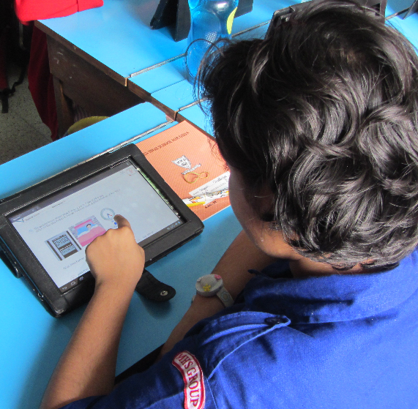
CLOUD BASED TECHNOLOGY
Examination Solutions for Schools
AMAZON WEB SERVICES (AWS) CLOUD BASED SYSTEM
AUTOMATIC SCALABLE NoSQL SYSTEM
UNLIMITED CONCURRENT LOGIN ACCESS
RESPONSIVE INTERFACE THAT WORKS ON ALL SYSTEMS
NO SEPARATE APPS OR PLUGINS NEEDED
SECURE DATA
ZERO DOWN TIME
API INTEGRATION WITH OTHER SYSTEMS
LARGE NUMBER OF STUDENTS SIMULTANEOUS ACCESS WHICH CAN BE USED EVEN FOR COMPETITIVE EXAMS
www.tecknowscope.com | www.lovemytest.com | Bengaluru India

Slide 12
Market Size
Examination Solutions for Schools
Size (Revenue) of the market which you are addressing
“The global Online Exam Proctoring market size was USD 438.8 million and it is expected to reach USD 1350.8 million by the end of 2027, with a CAGR of 17.4% during 2021-2027.”
Global Online Exam Proctoring Market Size, Share & Forecast 2027 (blueweaveconsulting.com)
Market Potential in terms of customer size based on demographics
The Schools market in India has 2.7 lac schools with 25 Crores students. On an average each student appears for 30 examinations in a year. Annually 750 Crore exams are conducted
Technology in Examination Conduction
Examination conduction is more or less an offline process now. However things will change in the next 3-5 years. Pandemic has brought in the urgency, but most schools have used google forms to conduct exams than using any professional software during the pandemic. Hence filling this gap is the need of the hour.
www.tecknowscope.com | www.lovemytest.com | Bengaluru India

Slide 13
Business Possibilities
Examination Solutions for Schools
Customers | Solutions | What we have/ Need to do
Schools Coaching Centres Tutors | Question Papers Online Exams Practice Tests Homework Assignments Admission Tests | Solution is working. Minor tweeaking and improvements required.
Colleges Technical Institutes Universities | Online Exams Entrance Tests | Test solution working, white labelling may be required
Retail students (School) | Practice Tests Competitive Exam Preparation Career orientation/Aptitude tests | School content available, needs to add more. Competitive exams content needed. System to be tweaked for self testing.
Corporates | Recruitment Tests Training Assessments | White labelling
Govt/Institutions | Learning Gap Analysis tests Entrance Exams Competitive Exams | Test conduction as a service
After College/Job Seekers | Job oriented exam preparation. General, IQ, UPSC, PSC, SSC | Content needs to be developed
www.tecknowscope.com | www.lovemytest.com | Bengaluru India

Slide 14
Business Projections
Examination Solutions for Schools
Business Model
Channel (Retailing, Partnering, B2B)
Partner model, Need to adopt B2C model by 2022-23
Revenue Model - Pricing and Revenue Forecast across years and how it will grow.
Schools/Institutes/Businesses (B2B) - Our Pricing is driven by volume of exams each school conducts. The price varies from Rs.10 per exam to Rs.3 per exam.
Retail Students/Job Seekers (B2C) - Price per test per student plans to be launched.
Customers | Avg Rev | 2022 | Rev | 2023 | Rev | 2024 | Rev | 2025 | Rev
Schools | 25000 | 25 | 625000 | 15 | 375000 | 50 | 1250000 | 100 | 2500000
Coaching centers Tutors | 5000 | 5 | 25000 | 25 | 125000 | 100 | 500000 | 500 | 2500000
Colleges Technical Institutes Universities | 200000 | 0 | 0 | 0 | 0 | 1 | 200000 | 5 | 1000000
Retail students (School) | 500 | 0 | 0 | 2000 | 1000000 | 10000 | 5000000 | 50000 | 25000000
Corporates | 50000 | 0 | 0 | 0 | 0 | 5 | 250000 | 10 | 500000
Govt/Institutions | 1000000 | 0 | 0 | 0 | 0 | 0 | 0 | 1 | 1000000
After College/Job Seekers | 1000 | 0 | 0 | 0 | 0 | 0 | 0 | 500 | 500000
Total |  |  | 650000 |  | 1500000 |  | 7200000 |  | 33000000
www.tecknowscope.com | www.lovemytest.com | Bengaluru India

Slide 15
Need of the Hour
Examination Solutions for Schools
BUSINESS DEVELOPMENT
Scaling the current business
Identifying new business areas
Getting the required features built
Marketing strategies
SCALING UP
Investments
New Related products and services
Collaborations or tie-ups
Funding through VC route
Take-over
www.tecknowscope.com | www.lovemytest.com | Bengaluru India

Slide 16
Tecknowscope Solutions LLP
THANK YOU!
CALL/WHATSAPP- 7829151919
MAIL: info@lovemytest.com
VISIT: lovemytest.com
ONLY FOR PRIVATE CIRCULATION.
All rights reserved by Tecknowscope Solutions LLP.
The information provided in this presentation is confidential in nature.
Please do not circulate to non-intended third parties.
www.tecknowscope.com | www.lovemytest.com | Bengaluru India

